Slide 1
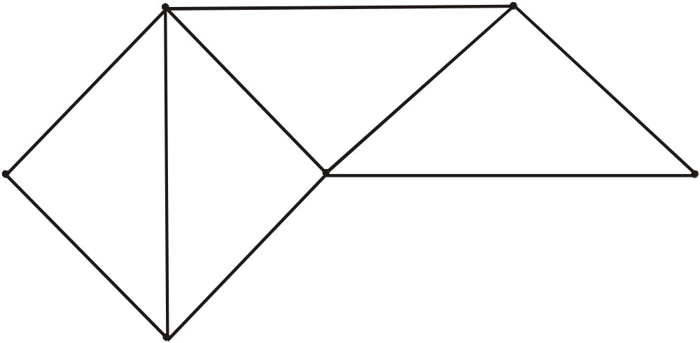
LECTUURE # 19
SPANNING TREE
  Suppose it is required to develop a system of roads between six major cities.
  A survey of the area revealed that only the roads shown in the graph could be constructed.
b
c
a
d
e
f

Slide 2
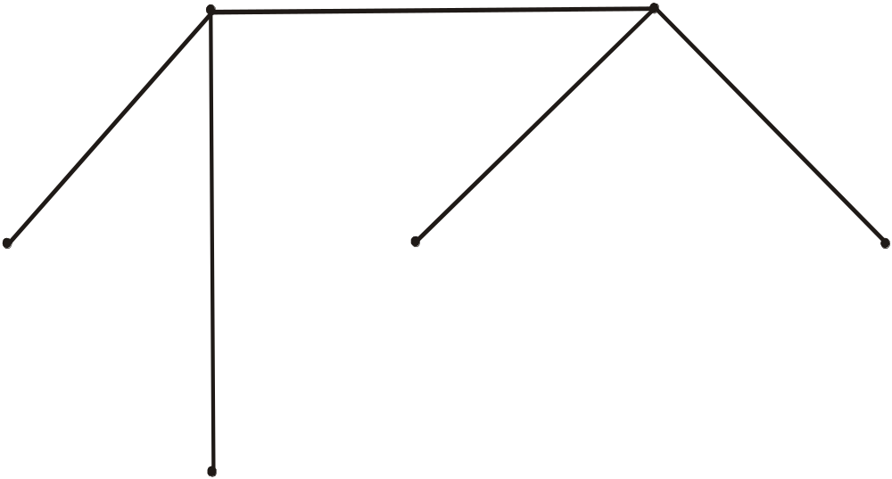
  For economic reasons, it is desired to construct the least possible number of roads to connect the six cities.
  One such set of roads is
  Note that the subgraph representing these roads is a tree, it is connected & circuit-free (six vertices and five edges)
b
c
a
e
d
f

Slide 3
SPANNING TREE
  A spanning tree for a graph G is a subgraph of G that contains every vertex of G and is a tree.
  REMARK
  1. Every connected graph has a spanning tree.
  2. A graph may have more than one spanning trees.
  3. Any two spanning trees for a graph have the same number of edges.
  4. If a graph is a tree, then its only spanning tree is the tree itself.

Slide 4
EXERCISE
  Find a spanning tree for the graph below:
b
c
a
d
e
f
  SOLUTION
  The graph has 6 vertices & 9 edges so we must delete 9 - 6 + 1 = 4 edges. We delete an edge in each cycle.
  1. Delete af 2. Delete fe
  3. Delete be 4. Delete ed
b
c
a
e
d
f

Slide 5
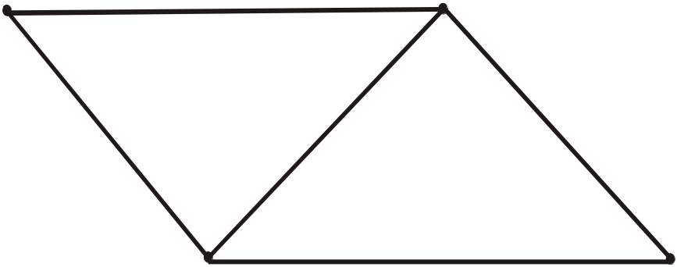
EXERCISE
  Find all the spanning trees of the graph given below.
v₀
v₁
v₃
v₂
  SOLUTION
  The graph has n = 4 vertices and e = 5 edges. So we must delete
  e - v + 1 = 5 - 4 + 1 = 2
  edges from the cycles in the graph to obtain a spanning tree.

Slide 6
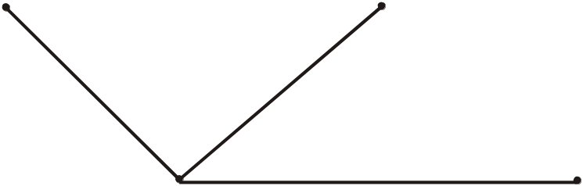
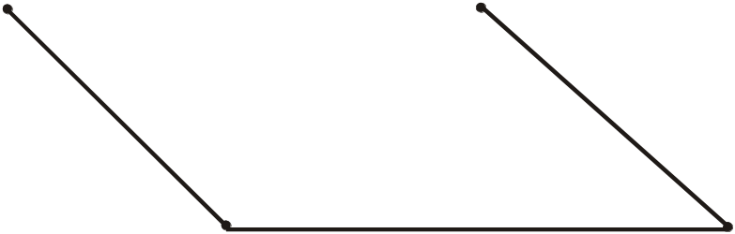
v₀
v₁
v₃
v₂
  (1) Delete v₀v₁ & v₁v₂ to get
v₀
v₁
v₃
v₂
  (2) Delete v₀v₁ & v₁v₃ to get
v₀
v₁
v₃
v₂

Slide 7

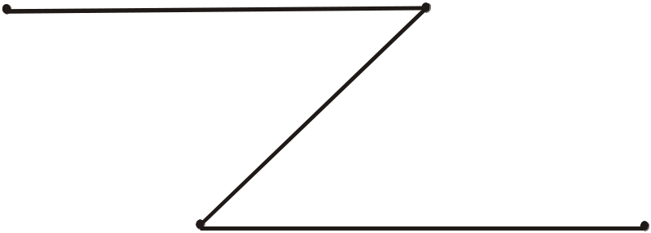
  Original Graph
v₀
v₁
v₃
v₂
  (3) Delete v₀v₁ & v₂v₃ to get
v₀
v₁
v₃
v₂
  (4) Delete v₀v₃ & v₁v₂ to get
v₀
v₁
v₃
v₂

Slide 8
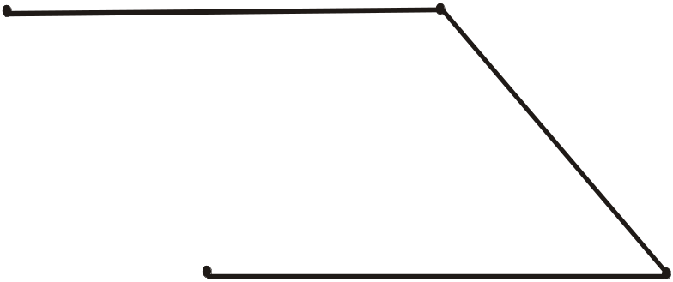
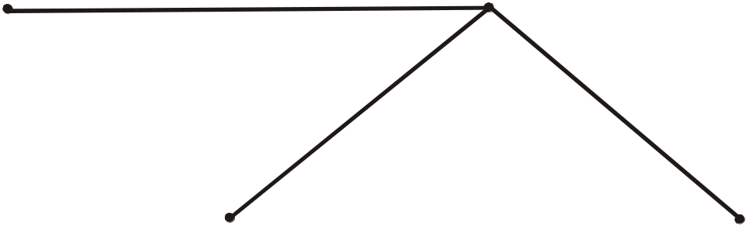
  Original Graph
v₀
v₁
v₃
v₂
  (5)Delete v₀v₃ & v₁v₃ to get
v₀
v₁
v₃
v₂
  (6)Delete v₀v₃ & v₂v₃ to get
v₀
v₁
v₃
v₂

Slide 9
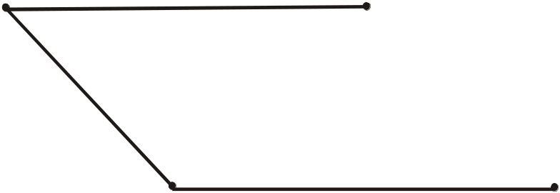
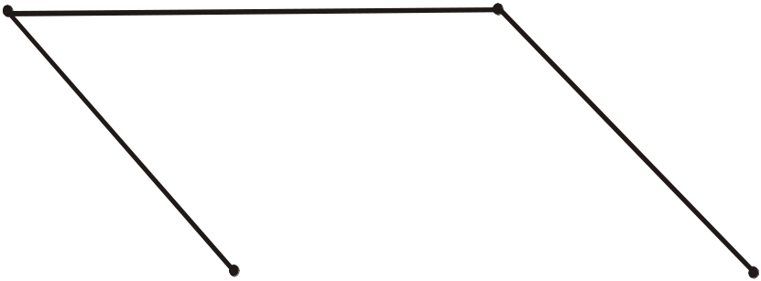
  Original Graph
v₀
v₁
v₃
v₂
  (7) Delete v₁v₃ & v₁v₂ to get
v₀
v₁
v₃
v₂
  (8) Delete v₁v₃ & v₂v₃ to get
v₀
v₁
v₃
v₂

Slide 10
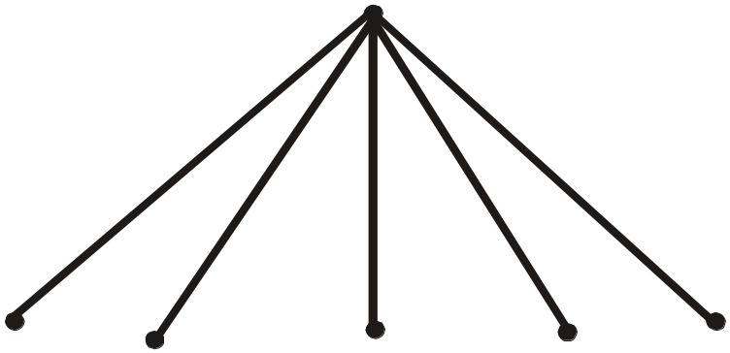
EXERCISE
  Find a spanning tree for each of the following graphs.
  (a) k_{1,5} (b) k₄
  SOLUTION
  (a) k_{1,5} represents a complete bipartite graph on (1,5) vertices, drawn below:
  Clearly the graph itself is a tree (six vertices and five edges). Hence, the graph is itself a spanning tree.

Slide 11
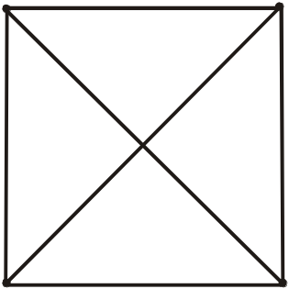
  (b) k₄ represents a complete graph on four vertices.
a
b
c
d
  Now
  Number of vertices = n = 4 and number of edges = e = 6
  Hence we must remove
  e - v + 1 = 6 - 4 + 1 = 3
  edges to obtain a spanning tree.

Slide 12
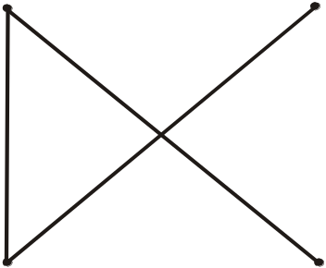
a
b
c
d
  Let ab, bd & cd edges are removed. The associated spanning tree is
a
b
c
d

Slide 13
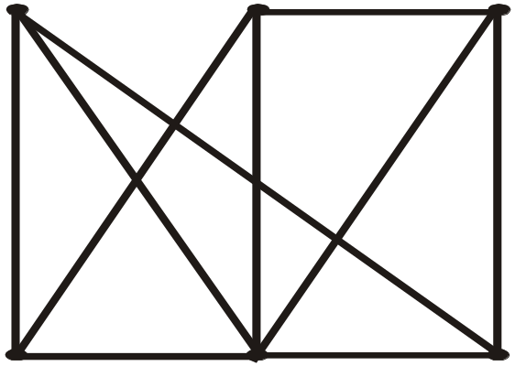
EXERCISE
  Suppose an oil company wants to build a series of pipelines between six storage facilities in order to be able to move oil from one storage facility to any of the other five. For environmental reasons it is not possible to build a pipeline between some pairs of storage facilities. The possible pipelines that can be build are.
a
b
c
f
e
d

Slide 14
SOLUTION
  Because the construction of a pipeline is very expensive, construct as few pipelines as possible.
  (The company does not mind if oil has to be routed through one or more intermediate facilities)
  The task is to find a set of edges which together with the incident vertices from a connected graph containing all the vertices and having no cycles. This will allow oil to go from any storage facility to any other without unnecessary building costs. Thus, a tree containing all the vertices of the graph is to be soughed. One selection of edges is

Slide 15
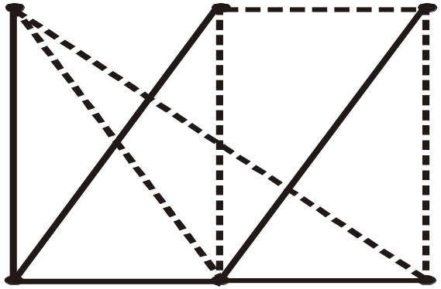
a
b
c
f
e
d
a
b
c
f
e
d

Slide 16
DEFINITION
  A weighted graph is a graph for which each edge has an associated real number weight.
  The sum of the weights of all the edges is the total weight of the graph.

Slide 17
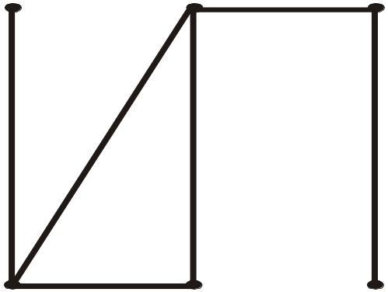
  EXAMPLE
  The figure shows a weighted graph with total weight
  2 + 6 + 3 + 2 + 3 + 1 = 17
3
2
6
2
1
3

Slide 18
MINIMAL SPANNING TREE
  A minimal spanning tree for a weighted graph is a spanning tree that has the least possible total weight compared to all other spanning trees of the graph.
  If G is a weighted graph and e is an edge of G then w(e) denotes the weight of e and w(G) denotes the total weight of G.

Slide 19
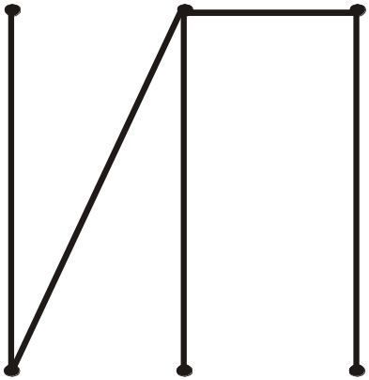
EXERCISE
  Find the three spanning trees of the weighted graph below. Also indicate the minimal spanning tree.
3
2
6
2
1
SOLUTION
3
  First Spanning tree we obtained by removing edge of weight 3.
T₁
3
w(T₁)=14
2
6
2
1

Slide 20
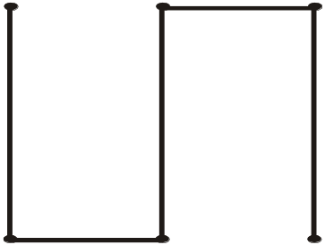
3
2
6
2
1
3
  Second Spanning tree we obtained by removing edge of weight 6.
T₂
3
w(T₂)=11
2
2
1
3

Slide 21
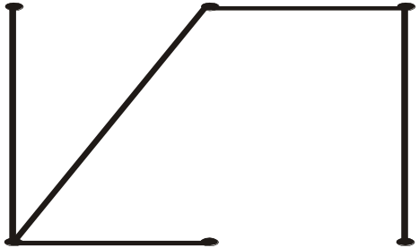
3
2
6
2
1
3
  Third Spanning tree we obtained by removing edge of weight 2.
T₃
3
2
6
1
w(T₃)=15
3
  T₂ is the minimal spanning tree, since it has the minimum weight among the spanning trees.

Slide 22
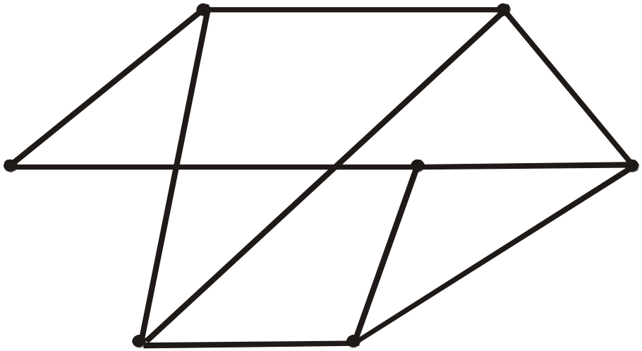
EXERCISE
  Use Kruskal’s algorithm to find a minimal spanning tree for the graph below. Indicate the order in which edges are added to form the tree.
b
7
c
1
4
8
10
e
a
d
9
3
2
5
g
6
f

Slide 23
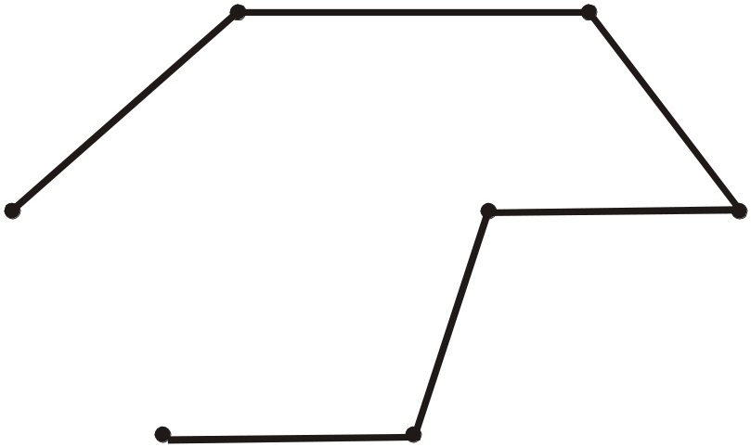
b
7
c
1
4
8
10
e
a
d
9
3
2
5
g
6
f
  SOLUTION: Minimal spanning tree
b
7
c
1
4
e
3
d
a
2
g
6
f
  Order of adding the edges:
  {a,b}, {e,f}, {e,d}, {c,d}, {g,f}, {b,c}

Slide 24
b
7
c
1
4
8
10
e
a
d
9
3
2
5
g
6
f
  SOLUTION: Minimal spanning tree
b
7
c
1
4
e
3
d
a
2
g
6
f
  Order of adding the edges:
  {a,b}, {e,f}, {e,d}, {c,d}, {g,f}, {b,c}

Slide 25
b
7
c
1
4
8
10
e
a
d
9
3
2
5
g
6
f
  SOLUTION: Minimal spanning tree
b
7
c
1
4
e
3
d
a
2
g
6
f
  Order of adding the edges:
  {a,b}, {e,f}, {e,d}, {c,d}, {g,f}, {b,c}

Slide 26
b
7
c
1
4
8
10
e
a
d
9
3
2
5
g
6
f
  SOLUTION: Minimal spanning tree
b
7
c
1
4
e
3
d
a
2
g
6
f
  Order of adding the edges:
  {a,b}, {e,f}, {e,d}, {c,d}, {g,f}, {b,c}

Slide 27
b
7
c
1
4
8
10
e
a
d
9
3
2
5
g
6
f
  SOLUTION: Minimal spanning tree
b
7
c
1
4
e
3
d
a
2
g
6
f
  Order of adding the edges:
  {a,b}, {e,f}, {e,d}, {c,d}, {g,f}, {b,c}

Slide 28
b
7
c
1
4
8
10
e
a
d
9
3
2
5
g
6
f
  SOLUTION: Minimal spanning tree
b
7
c
1
4
e
3
d
a
2
g
6
f
  Order of adding the edges:
  {a,b}, {e,f}, {e,d}, {c,d}, {g,f}, {b,c}

Slide 29
EXERCISE
  Use Prim’s algorithm starting with vertex a to find a minimal spanning tree of the graph below. Indicate the order in which edges are added to form the tree.
b
7
c
1
4
8
10
e
a
d
9
3
2
5
g
6
f

Slide 30
b
7
c
1
4
8
10
e
a
d
9
3
2
5
g
6
f
  SOLUTION: Minimal spanning tree
b
7
c
1
4
e
3
a
d
2
g
6
f
  Order of adding the edges:
  {a,b}, {b.c}, {c,d}, {d,e}, {e,f}, {f,g}

Slide 31
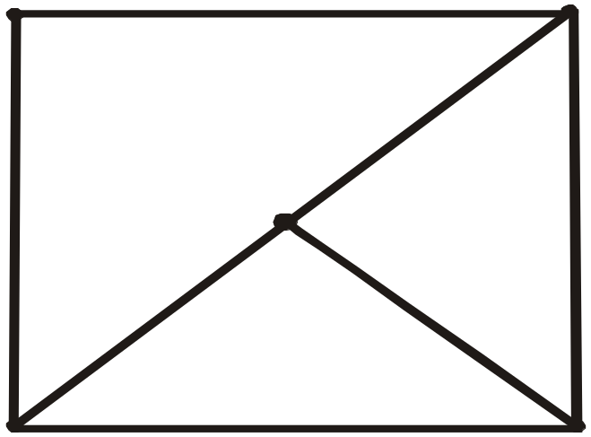
EXERCISE
  Find all minimal spanning trees that can be obtained using
  (a) Kruskal’s algorithm
  (b)Prim’s algorithm starting with vertex a
a
9
b
6
8
c
7
3
5
d
5
e

Slide 32
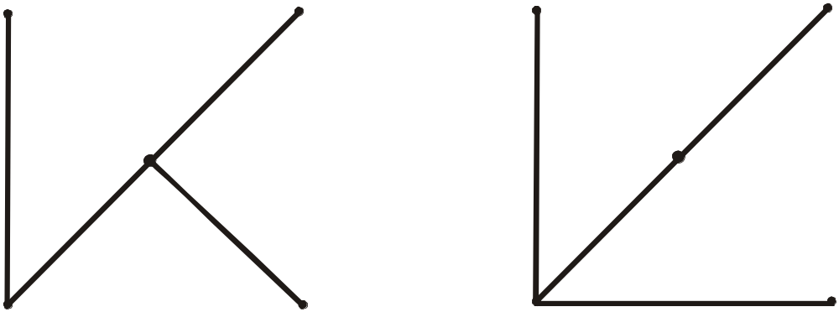
a
9
b
6
8
c
7
3
5
d
5
e
  SOLUTION
  (a) When Kruskal’s algorithm is applied, edges are added in one of the following two orders:
  1. {c,d}, {c,e}, {c,b}, {d,a}
  2. {c,d}, {d,e}, {c,b}, {d,a}
a
b
a
b
c
c
d
e
d
e

Slide 33
a
9
b
6
8
c
7
3
5
d
5
e
  (b)When Prim’s algorithm is applied starting at a, edges are added in one of the following two orders:
  1. {a,d}, {d,c}, {c,e}, {c,b}
  2. {a,d}, {d,c}, {d,e}, {c,b}
a
b
a
b
c
c
d
e
d
e

Slide 34
KRUSKAL’S ALGORITHM
  Input: G [a weighted graph with n vertices]
  1. Initialize T(the minimal spanning tree of G) to have all the vertices of G and no edges.
  2. Let E be the set of all edges of G and let m: = 0.
  3. While (m < n - 1)
  3a. Find an edge e in E of least weight.
  3b. Delete e from E.
  3c. If addition of e to the edge set of T does not produce a circuit then add e to the edge set of T and set m: = m + 1
  end while
  Output T

Slide 35
PRIM’S ALGORITHM
  Input: G[a weighted graph with n vertices]
  1. Pick a vertex v of G and let T be the graph with one vertex, v, and no edges.
  2. Let V be the set of all vertices of G except v
  3. for i: = 1 to n - 1
  3a. Find an edge e of G such that
  (1)e connects T to one of the vertices in V
  and (2)e has the least weight of all edges connecting T to a vertex in V.
  Let w be the end point of e that is in V.
  3b. Add e and w to the edge and vertex sets of T and delete w from V.
  next i
  Output: T
  end Algorithm

